Slide 1
Natural Gas World Presentation T. Robinson, Senior Vice President & General Manager Canada Gas Pipelines
February 7, 2018

Slide 2
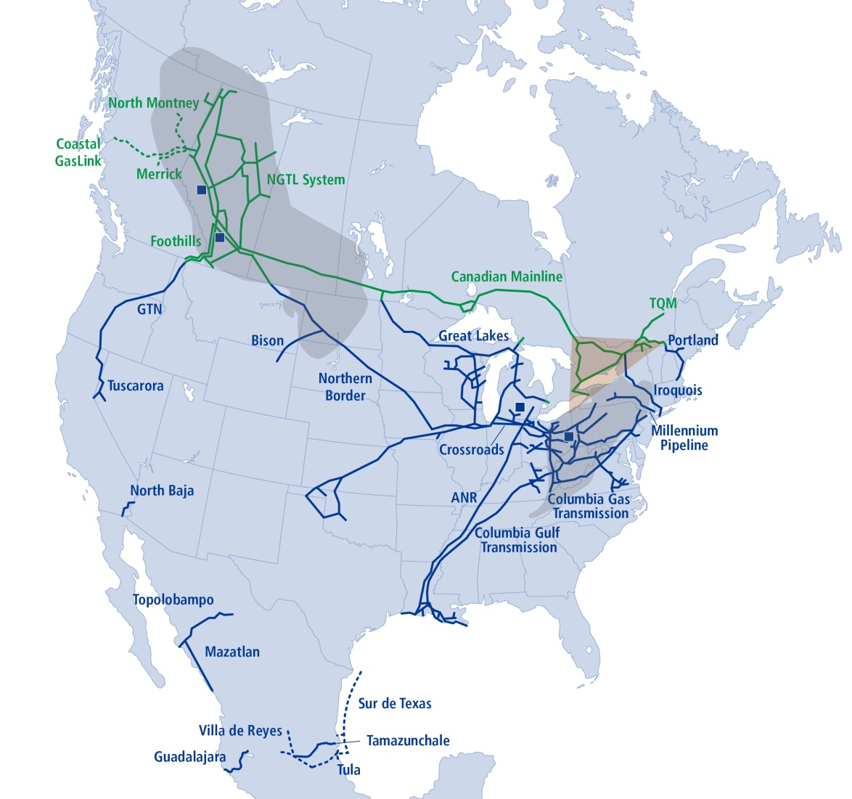
Natural Gas Pipelines
One of North America’s Largest Natural Gas Pipeline Networks
Operating 91,500 km (56,900 miles) of pipelines
Transports ~25 per cent of continental demand
North America’s Largest Natural Gas Storage Operator
More than 653 Bcf of capacity
Unparalleled connections from traditional and emerging basins to growing markets in Canada, the U.S. and Mexico
Notes:
TransCanada is one of North America’s largest natural gas transmission businesses with 91,500 kilometres or 56,900 miles of natural gas pipelines and 653 Bcf of gas storage capacity – enough to circle the Earth twice!
We supply 27 per cent of the natural gas consumed across North America every day.
Our natural gas business taps into virtually all major basins across Canada, the U.S. and Mexico.
Columbia Acquisition:
TransCanada Corporation (TSX:TRP) (NYSE:TRP) (TransCanada) today announced it has entered into an agreement and plan of merger pursuant to which it will acquire Columbia Pipeline Group, Inc. (NYSE:CPGX or Columbia), a Houston, Texas-based company that operates an approximate 24,000-kilometre (km) (15,000-mile) network of interstate natural gas pipelines extending from New York to the Gulf of Mexico, with a significant presence in the Appalachia production basin.
"The acquisition represents a rare opportunity to invest in an extensive, competitively-positioned, growing network of regulated natural gas pipeline and storage assets in the Marcellus and Utica shale gas regions," said Russ Girling, TransCanada's president and chief executive officer. "The assets complement our existing North American footprint which together will create a 91,000-kilometre (57,000-mile) natural gas pipeline system connecting the most prolific supply basins to premium markets across the continent. At the same time, we will be well positioned to transport North America's abundant natural gas supply to liquefied natural gas terminals for export to international markets."
Columbia owns one of the largest interstate natural gas pipeline systems in the United States, providing transportation, storage and related services to a variety of customers in the U.S. Northeast, Midwest, Mid-Atlantic and Gulf Coast regions. Its assets include Columbia Gas Transmission, which operates approximately 18,000 km (11,300 miles) of pipelines and 286 billion cubic feet of storage capacity in the Marcellus and Utica shale production areas, and Columbia Gulf Transmission, an approximate 5,400-km (3,300-mile) pipeline system that extends from Appalachia to the Gulf Coast.

Slide 3
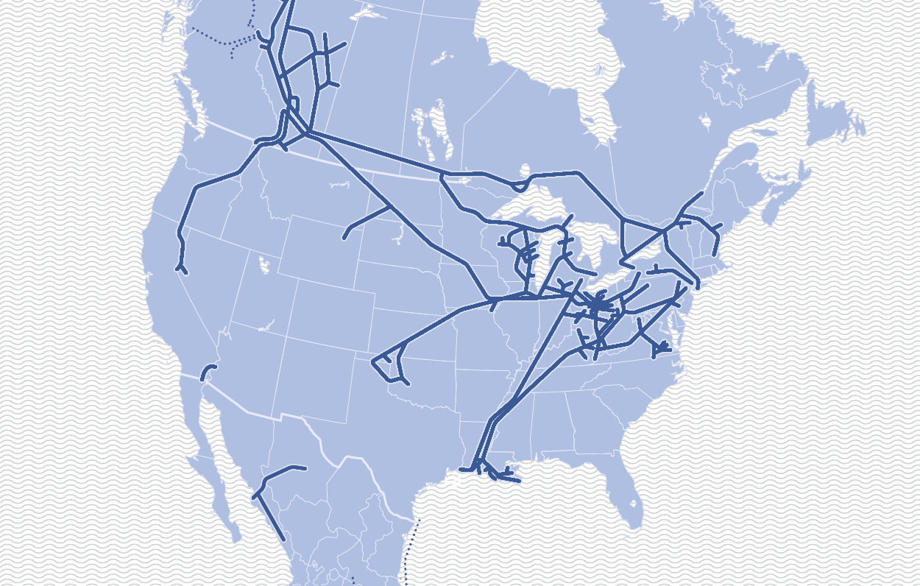
Increasing Competition from North American Basins
Daily Production (Bcf/d)
2017
2027
+3
15
13
+19
-2
+1
25
13
+4
6
+3
21
*All in Bcf/d; the production figures represented here are not inclusive of all N. American producing regions
3
Source: TransCanada Forecast

Slide 4
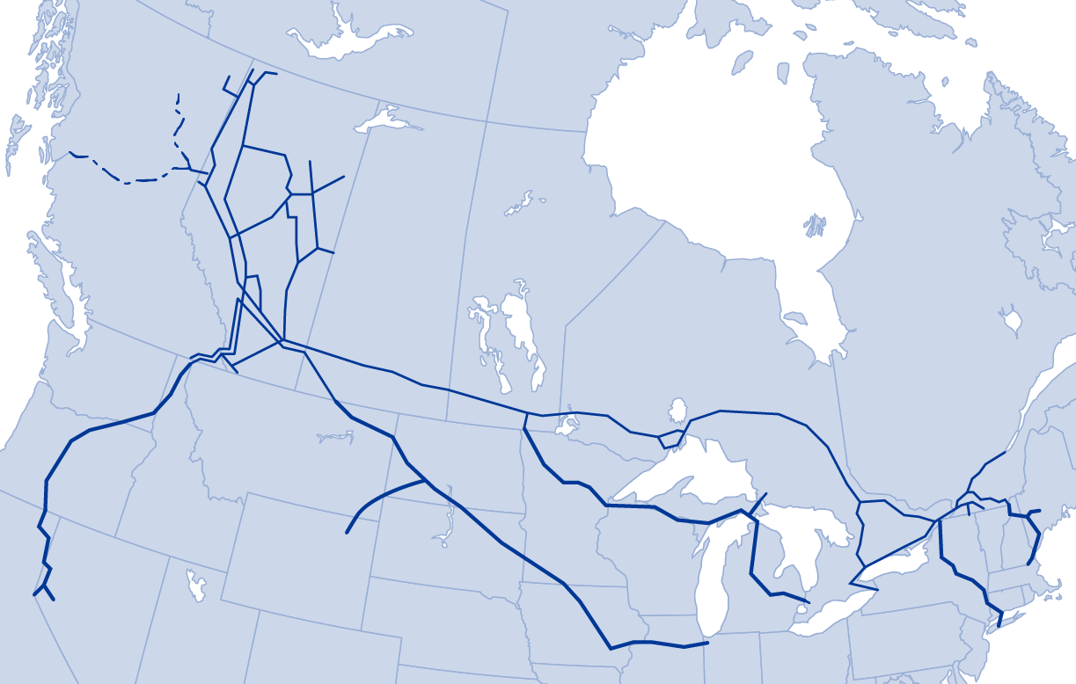
Connecting to Multiple Markets
Alberta and B.C.
1,858 Bcf
5.09 Bcf/d
44%
NGTL System Throughput
2017 total: 4,200 Bcf
2017 daily average: 11.5 Bcf/d
Eastern Canada /
Northeast U.S.
934 Bcf
2.56 Bcf/d
22%
Gas Transmission
Northwest
Canadian Mainline
Pacific Northwest /
California
803 Bcf
2.20 Bcf/d
19%
Northern Border
Pipeline
Portland Natural Gas Transmission
Midwestern U.S.
606 Bcf
1.66 Bcf/d
14%
Great Lakes Gas
Transmission
Iroquois Gas Transmission
Total 2017 deliveries
2017 average daily deliveries
% Annual NGTL throughput

Slide 5
Increasing WCSB Access to Export Markets
Alberta Expansions
550 MMcf/d
West Coast
LNG
East Gate Expansions
1.0 Bcf/d
LTFP
1.5 Bcf/d
Gas Transmission
Northwest
Canadian Mainline
Portland Natural Gas Transmission
West Gate Expansions
650 MMcf/d
Northern Border
Pipeline
Great Lakes Gas
Transmission
Iroquois Gas Transmission

