Slide 1

www.Peyto.com
Monetizing Gas In Western Canada
February 2018
Notes:
Good Morning Ladies and Gentlemen
Thank you to Dale and Natural Gas World for inviting me to participate on this panel and discuss some of the challenges facing the Canadian gas industry today.

Slide 2
Advisory
Regarding Forward-Looking Statements
This presentation contains forward-looking statements and forward-looking information within the meaning of applicable securities laws. The use of any of the words "expect", "anticipate", "continue", "estimate", "objective", "ongoing", "may", "will", "project", "should", "believe", "plans", "intends" and similar expressions are intended to identify forward-looking information or statements. More particularly and without limitation, this presentation contains forward looking statements and information concerning Peyto Energy Trust ("Peyto") production; reserves, resources and gas in place; undeveloped land holdings; reserve life index; product mix; business strategy; future development and growth prospects, profile targets and rates; prospects; asset base; tax pools; drilling locations and inventory, down-spacing potential; exploration risk; access to capital; future cash flow, value, debt levels and debt to cash flow; capital investment and expenditure programs and the funding thereof; anticipated cash-on-cash yield; net asset value; credit facility; and statements with respect to levels of dividends to be paid to shareholders, dividend policy, and the timing of payment of such dividends.
The forward-looking statements and information are based on certain key expectations and assumptions made by Peyto, including expectations and assumptions concerning prevailing commodity prices and exchange rates, applicable royalty rates and tax laws; future well production rates; reserve and resource volumes; the performance of existing wells; the success obtained in drilling new wells; and the sufficiency of budgeted capital expenditures in carrying out planned activities; and the availability and cost of labour and services. Although Peyto believes that the expectations and assumptions on which such forward-looking statements and information are based are reasonable, undue reliance should not be placed on the forward looking statements and information because Peyto can give no assurance that they will prove to be correct.
Since forward-looking statements and information address future events and conditions, by their very nature they involve inherent risks and uncertainties. Actual results could differ materially from those currently anticipated due to a number of factors and risks. These include, but are not limited to, the risks associated with the oil and gas industry in general such as operational risks in development, exploration and production; delays or changes in plans with respect to exploration or development projects or capital expenditures; the uncertainty of reserve and resource estimates; the uncertainty of estimates and projections relating to reserves, resources, production, costs and expenses; health, safety and environmental risks; commodity price and exchange rate fluctuations; marketing and transportation; loss of markets; environmental risks; competition; incorrect assessment of the value of acquisitions; failure to realize the anticipated benefits of acquisitions; ability to access sufficient capital from internal and external sources; and changes in legislation, including but not limited to tax laws, royalties and environmental regulations.
Readers are cautioned that the foregoing list of factors is not exhaustive. Additional information on these and other factors that could affect the operations or financial results of Peyto are included in reports on file with applicable securities regulatory authorities and may be accessed through the SEDAR website (www.sedar.com). The forward-looking statements and information contained in this presentation are made as of the date hereof and Peyto undertakes no obligation to update publicly or revise any forward-looking statements or information, whether as a result of new information, future events or otherwise, unless so required by applicable securities laws.
The information contained in this presentation does not purport to be all-inclusive or to contain all information that a prospective investor may require. Prospective investors are encouraged to conduct their own analyses and reviews of Peyto and of the information contained in this presentation. Without limitation, prospective investors should consider the advice of their financial, legal, accounting, tax and other advisors and such other factors that they consider appropriate in investigating and analyzing Peyto.
Reserves
The recovery and reserve estimates of Peyto's crude oil, natural gas liquids and natural gas reserves provided in the presentation are estimates only and there is no guarantee that the estimated reserves will be recovered. Actual crude oil, natural gas liquids and natural gas reserves may be greater than or less than the estimates provided herein. Reserve and production volumes are quoted before royalty deductions.
Barrels of Oil Equivalent
"Boe" means barrel of oil equivalent on the basis of 1 boe to 6,000 cubic feet of natural gas. Boe's may be misleading, particularly if used in isolation. A boe conversion ratio of 1 boe for 6,000 cubic feet of natural gas is based on an energy equivalency conversion method primarily applicable at the burner tip and does not represent a value equivalency at the wellhead.
Original Gas in Place
Original gas in place includes both discovered and undiscovered resources, and there is no certainty that any portion of the undiscovered resources will be discovered and, if discovered, that any volumes will be economically viable or technically feasible to recover or produce. Original gas in place also includes volumes that have already been produced from such accumulations. Readers should not unduly rely upon estimates of original gas in place in terms of assessing the combined company's reserves or recoverable resources.
Prices
All dollar values are quoted in Canadian currency.
Notes:
Just an advisory that I may disclose some forward looking statements about Peyto this morning, so please don’t hold them against me.

Slide 3
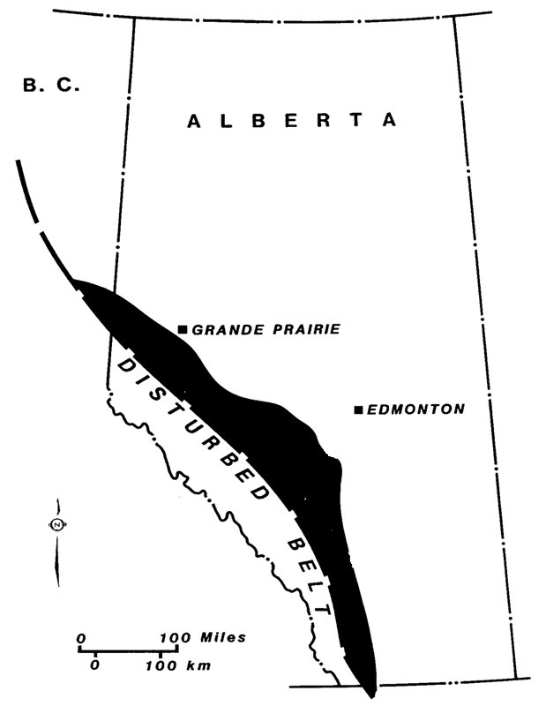
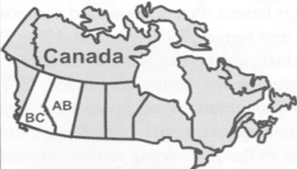
PEY.TO
Who We Are
  5th Largest Natural Gas Producer in Canada, 20 yrs old
  Pure Play Alberta Deep Basin – 110-115,000 boe/d Gas & NGLs
  Returns Focused Strategy – Avg ROCE 17%, ROE 31% over last 18 yrs among highest in industry
  Long Reserve Life Asset - 7 yrs PDP, 18 yrs 2P, sweet gas, no mobile water
  Lowest Cost Producer - $0.76/mcfe ($4.58/boe) 2017Q3 total cash costs
  Own and Control - Operate 99% of production, Own/operate gas plants
Monthly Dividend: $0.06/share (CTD 12/17 $18.29/share)
Shares O/S: 164.9 million (3% insider ownership)
Q3 2017 Net Debt*: $520 million (senior unsecured notes, 3.7-4.9%CND)
$770 million ($1.3B unsecured bank facility)
$1.29B ($1.82B total capacity)
Enterprise Value: $3.4 billion ($13/share)
Full Time Employees: 54
*subsequent to Q3 on Jan 2, 2018 Peyto issued $CND100MM of senior unsecured notes which increased total capacity to $1.92B and reduced revolving debt to $670MM.
Cash costs are royalties, operating costs, transportation, G&A and interest
BOE factor - 6 mcf = 1 bbl of oil equivalent
www.Peyto.com
Notes:
As Dale mentioned, I’m the President and CEO of Peyto
Peyto is the 5th largest natural gas producer in Canada and is embarking on it’s 20th year in operations. So I guess that also makes us one of the older producers in the industry too. I’ve been there since almost the beginning and lack the hair to show for it.
We are a pure play Alberta Deep Basin producer with around 90% gas and 10% natural gas liquids
Our strategy is a returns focused strategy and we’ve achieved some of the highest long term returns in the industry on the capital we’ve deployed, over 2.3B$ in cumulative earnings on $5.6B of cumulative capital investment.
Much of that has to do with an industry leading cost structure and an asset that we own and control. It’s also an asset that we built almost exclusively organically.

Slide 4
What’s Happened To Gas?
Gas Market For Canadian Exports Is Gone
Room for Canadian gas exports in the US market has completely disappeared. Yet Canada still has close to 4 BCF/d of excess supply.
Notes:
So, perhaps to kick off this mornings discussion about the gas industry in Canada,
I’d bring everyone up to speed on what’s happened recently.
As you’ve all probably seen or heard the US has recently become self sufficient in meeting it’s natural gas needs, growing production over the last decade to about 75 BCF/d to match the 75 BCF/d or so of domestic demand.
For the last 30 years that wasn’t the case, which is why Canada was able to develop and sell so much extra production relative to it’s domestic demand, because we sold our extra into the US market.
Now, that hole in the US domestic market is effectively gone. Perhaps it will return if the US can’t continue to supply their own demands or perhaps, as some suggest, it’s gone for good.
Either way, for now, we no longer have a captive market for our 4 bcf/d of extra supply.

Slide 5
What’s Happened AECO?
Canadian Gas Prices Have Collapsed
Historically we could compete with the US gas producers because we received the same price. Now our price is severely discounted to theirs.
Sub $2/GJ
The New World?
Notes:
This has obviously had a significant impact on the relative price of natural gas in Western Canada as compared to the US.
For the entire time we had a captive market in the US, Western Canadian gas prices traded at a similar price to the US, after you adjust for currency and transport.
Now, the forward strip price for Western Canadian gas trades at a significant discount, at less than $2/GJ Canadian or $1.70/MMBTU US relative to a $2.80/MMBTU US price
And that is the forecast for the foreseeable future.

Slide 6
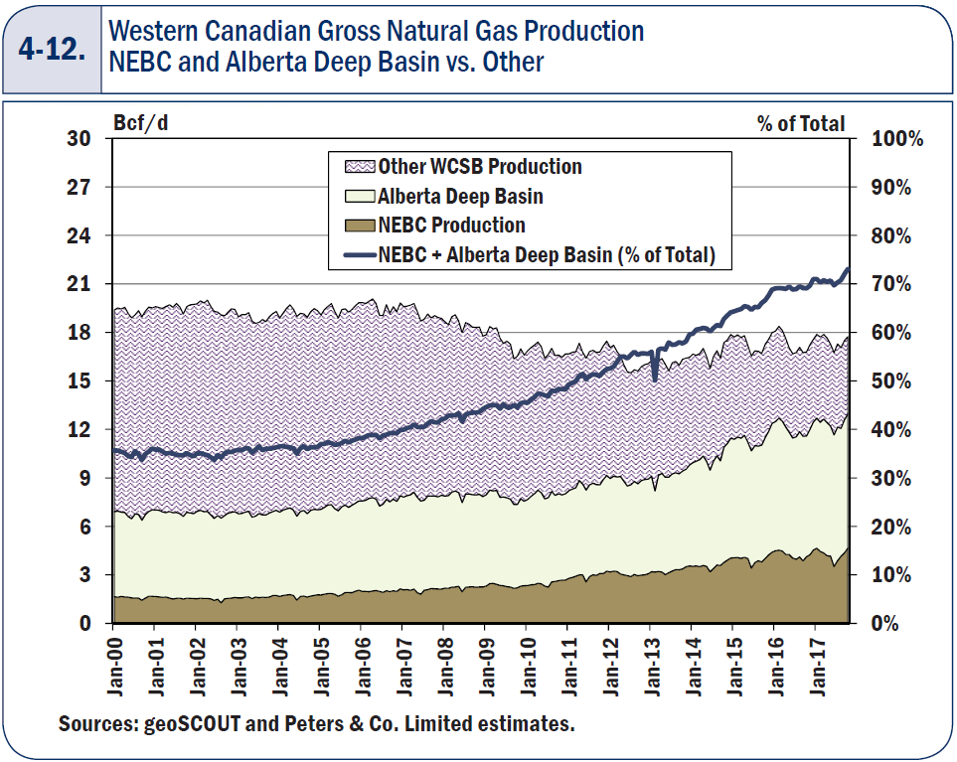
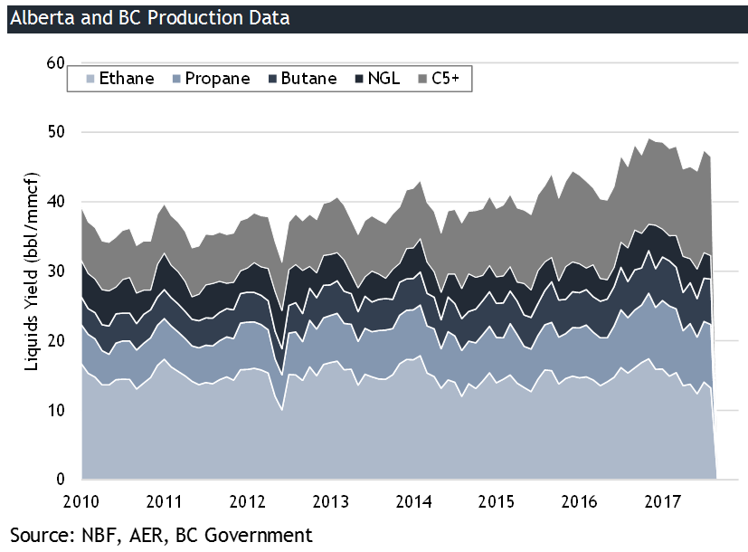
Can Liquids Save You?
Average Deep Basin/Montney Is 40 bbl/mmcf
The Deep Basin and Montney have increased from 50% of the basin to 70+% and their 40 bbl/mmcf liquids have increased basin yields from 20 bbl/mmcf to 30 bbl/mmcf (C3+)
30 BBL/
MMcf
Dry Gas
Liquids Rich Gas
Notes:
So one of the questions we wanted to discuss this morning is:
Can Canada maintain it’s current supply with such low gas prices? Or does it need to find a new market for it’s excess supply?
Some might suggest we can, because we produce enough natural gas liquids to improve the total revenue stream. So we are then able to sell the gas at a steep discount.
For instance, the Alberta Deep Basin and the Alberta and BC Montney, where all the gas wells have been drilled over the last 5 years, have an average liquid yield (propane, butane, condensate) of 40 bbl/mmcf which has increased the basin average from 20 bbl/mmcf back in 2010 to 30 bbl/mmcf today.
The Deep Basin and Montney now represent about 70% of total Western Canadian Supply.

Slide 7
Can Liquids Save You?
Is 40 bbl/mmcf Enough For Sub-$2/GJ Gas?
The average gas producer has >$4.00/mcfe total supply cost and that’s after bringing costs down for the last several years.
BOE factor - 6 mcf = 1 bbl of oil equivalent
Source: GMP First Energy, ₁-2016 PDP FD&A n/a
Notes:
But is 40 bbls/mmcf enough considering we may have a sub-$2 gas price for the foreseeable future?
Looking at the supply costs for the gas producers in the industry, the average sits at around $4/mcfe Canadian.
And that’s for producers that have on average 20% liquids production and 80% gas production, which is almost exactly that 40 bbl/mmcf that the average Deep Basin and Montney produce.

Slide 8
Can Liquids Save You?
Or Has Technology Already Done Enough?
Peyto has cut total supply costs in half due to the adoption of horizontal drilling in the Deep Basin
-50%
BOE factor - 6 mcf = 1 bbl of oil equivalent
Source: Peyto
Notes:
And the industry has been doing a great job of lowering it’s supply cost over the last decade or so.
Looking at Peyto for example, we’ve dropped total supply cost by almost 50% in the last 8 years. And that’s after the implementation of the new horizontal multi stage frac well designs in 2009.

Slide 9
Can Liquids Save You?
Is 40 bbl/mmcf Enough For Sub-$2/GJ Gas?
40 bbl/mmcf is 20% liquids/80% gas production and at $75 oil and $2/GJ gas (38:1), it doesn’t generate enough revenue to cover the average supply cost
$1.76
$1.87
$3.63
($2.23)
($1.75)
($3.98)
($0.35)
80% Gas @ $2.00/GJ AECO*110% heat content
20% NGLs @ $56/bbl (75% of oil*$75/bbl)
$3.63/mcfe
Revenue
$/mcfe
Royalties ($0.17)
Opex+transp ($1.53)
G&A ($0.31)
Interest ($0.21)
Total Costs ($2.23)
Cash Costs
Capital Costs(PDP FD&A)
2016 PDP FD&A
$1.75/mcfe
2016 Full Cycle Supply Cost $/mcfe
Full Cycle Netback
$/mcfe
The average gas producer needs $2.11/mcfe of revenue from gas or $2.40/GJ to break even
BOE factor - 6 mcfe = 1 boe of oil equivalent
Notes:
But if we run $2 gas and $75 oil prices against the average gas producers supply of 40 bbl/mmcf and with supply cost of close to $4/mcfe…
There isn’t enough revenue to cover the average producers full cycle costs.
In fact, just to break even, the average gas producer would need a gas price of $2.40/GJ.
And as we saw earlier, the price doesn’t exist on the forward strip for as far as we can see.
You can see here that at those prices, the 20% liquids production contributes over 50% of the revenue.

Slide 10
Can Liquids Save You?
If Canadian Differentials Drop Then What?
Liquids revenues are already more than 50% of totals for gas producers with 40 bbls/mmcf, they can’t afford to lose that
Notes:
And that math assumes we continue to have a $75 oil price in Canada, which is close to a 38:1 oil to gas price ratio.
That’s not a ratio we’ve seen very much over the last 20 years.
If oil prices were to fall to a more historical ratio of, say 20:1, then for sure there won’t be enough revenue to cover producer supply costs.

Slide 11
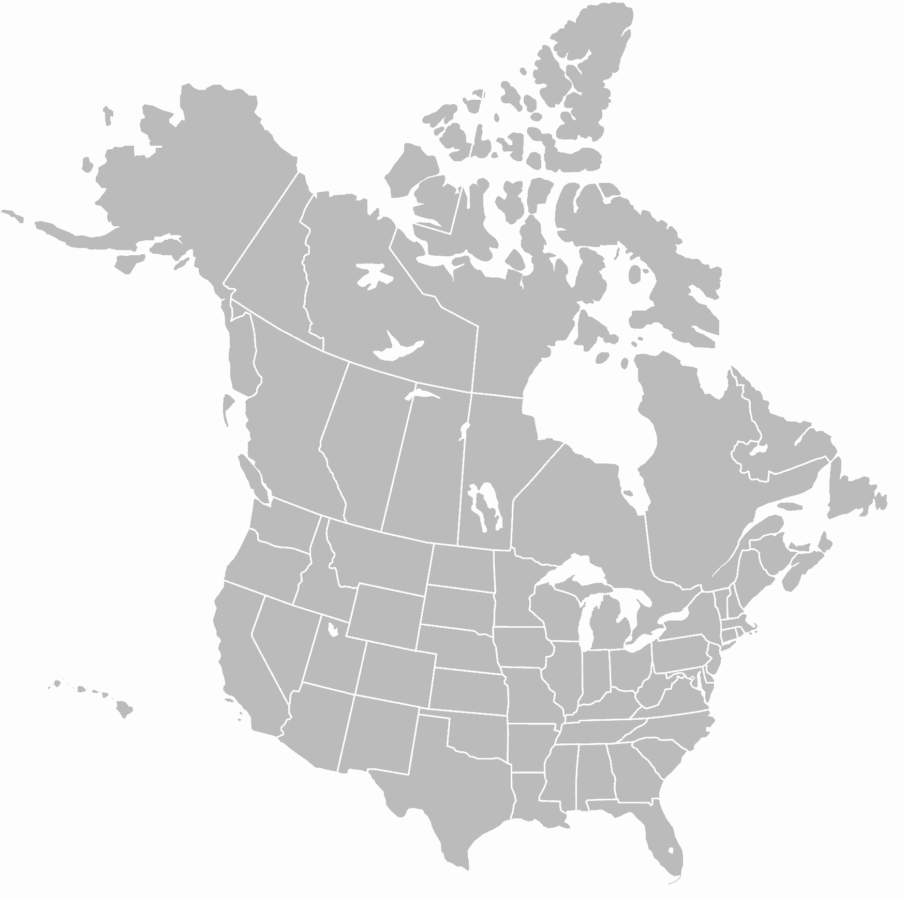
Egress Options
Can Gas Producers Get A Better Price?
With the base cost of egress >1/3 the value of the commodity (prior to the current marketing premiums) there is no net price above CND$2.10/GJ available to producers
Market | 2018 Market Price CND$/GJ | Full Path Transport Cost (Firm+Fuel) CND$/GJ | Net Price Received CND$/GJ | Transport Costs as % of Price
NYMEX (US$/MMBTU) | $2.80
To AECO | $1.23 | $0.21 | $1.02 | 17%
To Malin | $2.49 | $0.88 | $1.61 | 35%
To Chicago | $2.98 | $0.98 | $2.00 | 33%
To Dawn (via LTFP) | $3.13 | $1.24 | $1.89 | 40%
To Dawn (Full Toll) | $3.13 | $1.80 | $1.32 | 58%
To Henry Hub | $3.32 | $1.24 | $2.08 | 37%
$ ?
$0.21
Kitimat
$1.24 or $1.80
AECO
$0.88
$0.98
Malin
$1.24
Dawn
Chicago
Henry Hub
All prices in $CND/GJ as at Feb 5, 2018
Source: TD, TCPL, BMO
Notes:
So if the average gas producer can’t make enough revenue from the current commodity prices to cover his supply cost, can he find a better price elsewhere?
The answer is, not really.
Even with the current regulated tolls, and even if you could find service on the export pipes out of Alberta, using a $2.80/MMBTU US price, the net realized price back in Western Canada is only just over $2/GJ Canadian. Still below the required $2.40/GJ break even.
And most of the producers in Western Canada actually can’t get service at the regulated tolls. The majority of the service is held with marketing companies that, today, are charging a significant premium to those regulated tolls because there is more supply trying to get out of the basin than there is capacity.

Slide 12
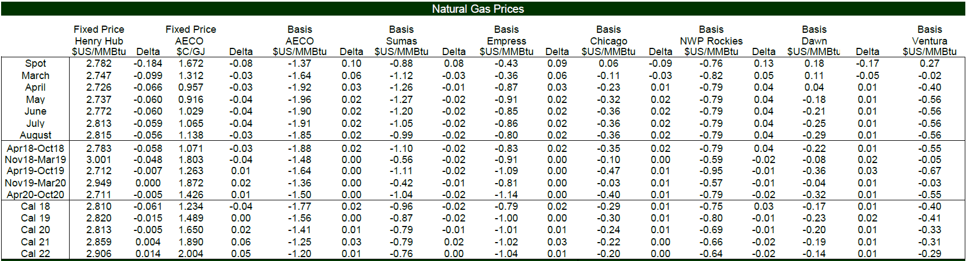
Egress Options
Lower Tolls Are Required To Get A Sufficient Price
Most of the transport out of Alberta is currently priced at a significant premium over regulated tolls which is why the AECO discount is so large.
Premium to $1.05US/MMBTU Toll
169%
149%
135%
119%
114%
$2.81US/MMBTU
-$1.77US/MMBTU
$1.04US/MMBTU
$1.23CND/GJ
The average gas producer in Canada needs $2.40/GJ just to cover supply cost so $1.23/GJ won’t cut it
All prices dated Feb 1, 2018, using C
Source: TD
Notes:
Here’s the current forward strip as evidence of this significant premium being charged for service out of the basin.
Obviously, the realized prices back in Alberta aren’t nearly enough to cover the average producers supply cost.

Slide 13
Now What?
Supply Shrinks And Domestic Demand Increases
Supply Shrinks
Drilling stops
Natural decline starts
High cost supply shut in
Capital unavailable
Demand Increases
Local power generation
Gas to liquids (C3+ extraction, Methanol, Urea)
Oilsands demand growth
This supply decline was due to low gas prices
Notes:
So then what going to happen?
I’ll admit that the crystal ball I’m staring into right now is particularly cloudy, but I will throw out what should happen.
In order to get a price that will allow producers to break even on their full cycle costs, we need to rebalance supply and demand in Western Canada.
Which means we need to shrink supply and/or increase local demand.
Shrinking supply means cutting capital programs, reducing drilling, and shutting in high cost supplies. Just like we did from 2008 to 2012 when gas prices dropped from $7.70 to $2.30.
And Growing demand means, increasing the local consumption of gas to alleviate the excess we have to export.

Slide 14
Solutions
A North American Market Share Battle
More Pipe + Lower Tolls = Growth
Same Pipe + Higher Tolls = Decline
Notes:
The other alternative is to improve our ability to compete in this North American market share battle.
That means more pipe to the US market at lower tolls. Which would allow the Canadian producers just enough price to grow the basin.

Slide 15
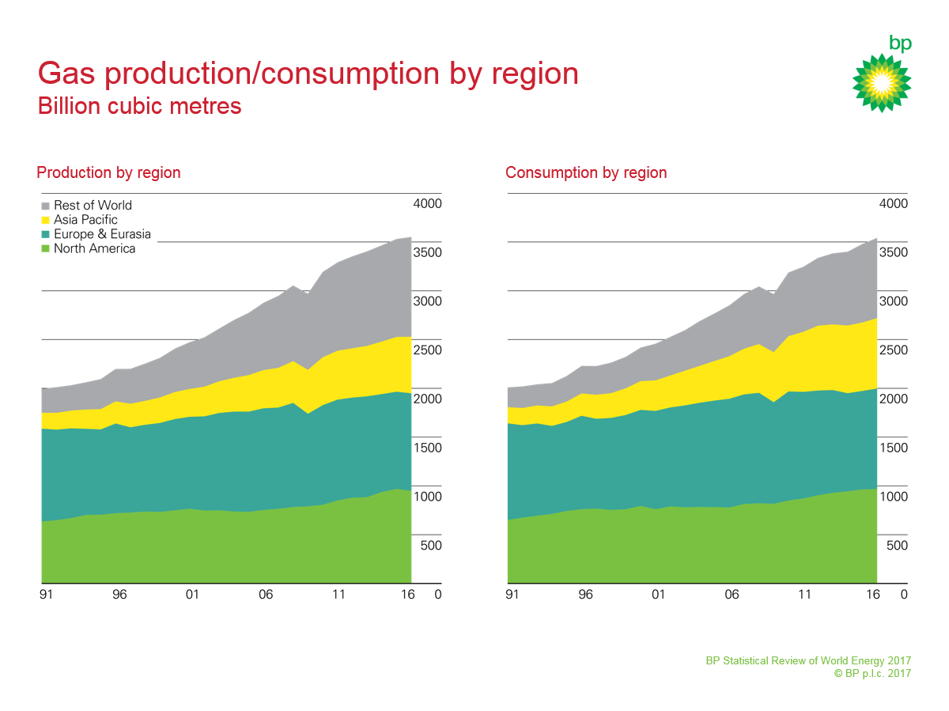
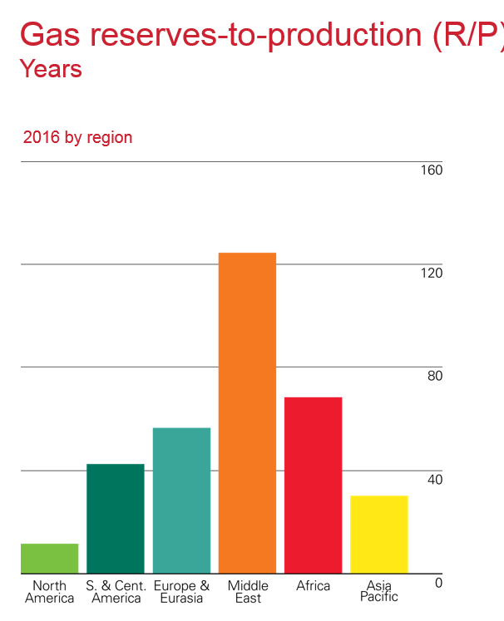
The Future
The Glass Is Half Full
The sheer size of the North American market relative to its very short reserve life means any excess supply could be very short lived
North America is one of the largest natural gas markets in the world at close to 100 BCF/d.
North America has the shortest reserve life of any market in the world.
Source: BP Statistical Review of World Energy 2017
Notes:
I realize all of that sounds rather bearish from a producers perspective so let me leave you on a positive note.
North American Demand for gas has never been greater. We have one of the largest regional markets for gas in the world supported by the smallest amount of reserves.
So any abundance of supply we have today that is swinging the market in one direction could be very short lived.
That’s it for me. Thank you for listening.

